Slide 1

Module 5
Unity Input

Slide 2
Content (slot 2)
Gamepad Input
Putting It All Together

Slide 3
5.4 Gamepad Input
Processing gamepad input is very similar to processing keyboard input.
We'll use a 360 controller as our gamepad, but Unity supports a wide variety of controllers.
By default, our Unity game contains 2 Horizontal axes: one with Type set to Key or Mouse Button and one with Type set to Joystick Axis.
In fact, we get 2 of many of the default axes, which makes it very easy to port the input processing from mouse/keyboard input to gamepad input.
In our current example, we don't even need to change any code to do that.
We still need to add another axis to blow up the teddy bear using a joystick button.

Slide 4
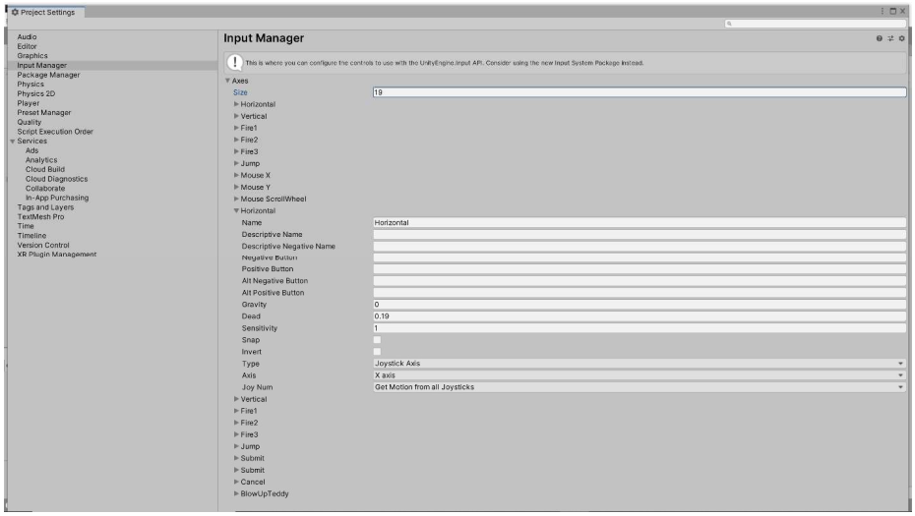
5.4 Gamepad Input
Joystick Horizontal Axis

Slide 5
5.4 Gamepad Input
Because each input axis can only have two positive buttons (Positive Button and Alt Positive Button), and because our BlowUpTeddy axis already uses both of them for the space bar and the left mouse button, we don't have any more room in that axis.
The good news is that we can create another axis with the same name to detect the joystick button press. When we call the GetAxis method in our script, it gets the input from all the axes with the name we provided; that's why we can have two Horizontal axes in the default game.

Slide 6
5.4 Gamepad Input
Add another input axis called BlowUpTeddy, set the Positive Button to joystick button 0 and make sure the Alt Positive Button is blank.
Make sure the Type is set to Key or Mouse Button, which is used for joystick buttons as well. We know we're not trying to use a Joystick Axis to blow up the teddy bear, we're trying to use a joystick button.
By the way, on a 360 controller joystick button 0 is A, joystick button 1 is B, and so on.

Slide 7
5.5 Putting It All Together
The problem description:
The player uses the keyboard to drive a fish around the game world, eating teddy bears with the head of the fish. The teddy bears bounce off the sides of the screen as they move around until they're eaten by the fish, at which point they're removed from the game. If a collision between the fish and a teddy bear isn't at the head of the fish, the teddy bear bounces off the fish. Teddy bears spawn at random intervals between 1 and 2 seconds.
Understand the Problem:
There are lots of details to work out as we build the game, but the rules of the game seem pretty straightforward, so we can move on to our design.

Slide 8
5.5 Putting It All Together
Design a Solution:
We only need two game objects in the game: TeddyBear and Fish.
The TeddyBear game object behaves just as it did in the “game” in module 4.6, so we'll just reuse the TeddyBear script and all the game object components we used there here as well. We'll also reuse the TeddyBearSpawner and Timer scripts from our solution to that problem.
To the Fish game object, we're definitely going to need a new Fish script to implement the required functionality. There are two key pieces of functionality we need in the Fish game object:
moving and facing the right way based on player input
handling collisions with TeddyBear game objects properly.

Slide 9
5.5 Putting It All Together
Design a Solution:
Because the Fish game object movement is like the TeddyBear game object responding to keyboard input, we'll start with the fields for the movement amount, fish collider dimensions, and the screen edges.
Because we need different sprites for facing left and facing right, we'll include fields for each of those sprites. Because we'll need a reference to the SpriteRenderer component every time we need to change the sprite, we'll store that in a field for efficiency.
For methods, we'll need the Start method to initialize lots of our fields and Update and ClampInScreen methods to respond to player input.

Slide 10
5.5 Putting It All Together
Design a Solution:
Although it might make sense to you that we should use the Update method for this, we should use the OnCollisionEnter2D method instead. That's because the OnCollisionEnter2D method is called “when an incoming collider makes contact with this object's collider.”

Slide 11
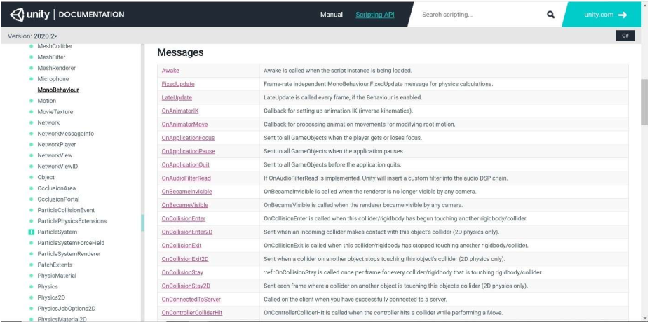
5.5 Putting It All Together
Design a Solution:
MonoBehaviour Messages (Methods)

Slide 12
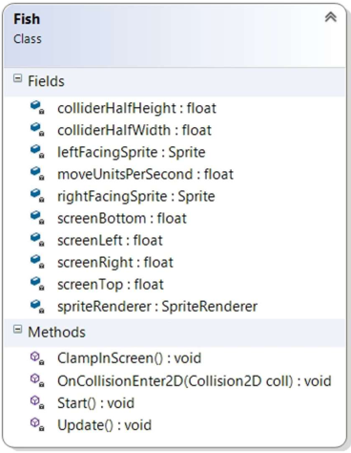
5.5 Putting It All Together
Design a Solution:
Fish UML

Slide 13
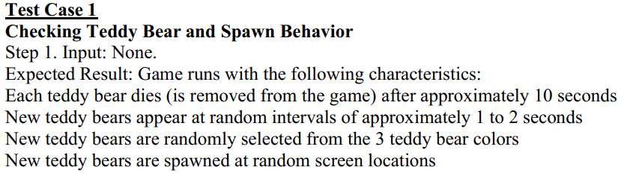
5.5 Putting It All Together
Write Test Cases

Slide 14
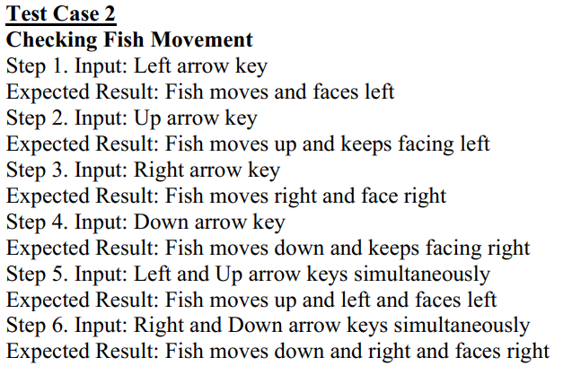
5.5 Putting It All Together
Write Test Cases

Slide 15
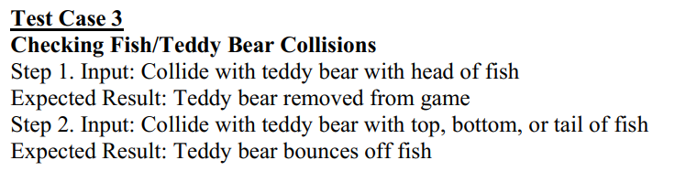
5.5 Putting It All Together
Write Test Cases

Slide 16
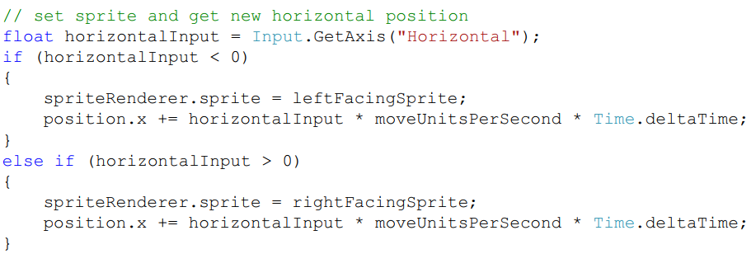
5.5 Putting It All Together
Write the Code
change the code in the Update method that moves the fish based on Horizontal input:

Slide 17
5.5 Putting It All Together
Write the Code
All we have left is making it so the fish can eat teddy bears with its head.
Do that in the OnCollisionEnter2D method.
When we detect a collision with a teddy bear, if the collider for the teddy bear intersects with the bounding box at the fish's head, we'll eat (destroy) the teddy bear.
When a collision occurs, we'll have to first move the fish head bounding box to the appropriate side of the fish (the left if the fish is facing left and the right if the fish is facing right).
If we look at the method header for the OnCollisionEnter2D method, we see there's a Collision2D object as the only parameter. The Collision2D documentation shows that we can access the collider property of that object to get the teddy bear's collider.

Slide 18
5.5 Putting It All Together
Write the Code
The collider is a Collider2D object, which has a bounds property of type Bounds for the “world space bounding area of the collider.”
Bounds objects are bounding boxes, so if we have Bounds objects for the teddy bear collider and the fish head, we can check to see if they intersect to determine whether or not the collision occurred at the head of the fish.

Slide 19

5.5 Putting It All Together
Write the Code
Bounds Documentation

Slide 20
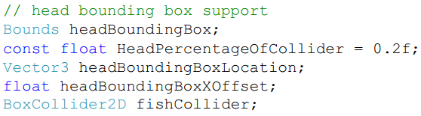
5.5 Putting It All Together
Write the Code
Add several fields to the Fish class:
The headBoundingBox field holds the bounding box for the fish's head.
The HeadPercentageOfCollider tells us how much of the fish collider represents the head of the fish.
The headBoundingBoxLocation field is used to to move the bounding box to the correct side of the fish on a collision.
The headBoundingBoxXOffset saves the x offset we need to apply from the center of the collider to move the bounding box the correct amount to get it to the front of the fish.

Slide 21
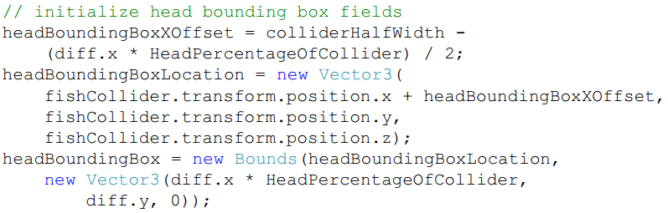
5.5 Putting It All Together
Write the Code
The fishCollider is a reference to the BoxCollider2D component of the Fish so we don't have to look that up every time we have a collision.
Add code to the Start method to initialize these fields:

Slide 22
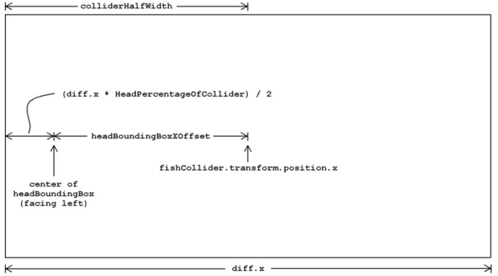
5.5 Putting It All Together
Write the Code
Head Bounding Box X Offset Calculation

Slide 23
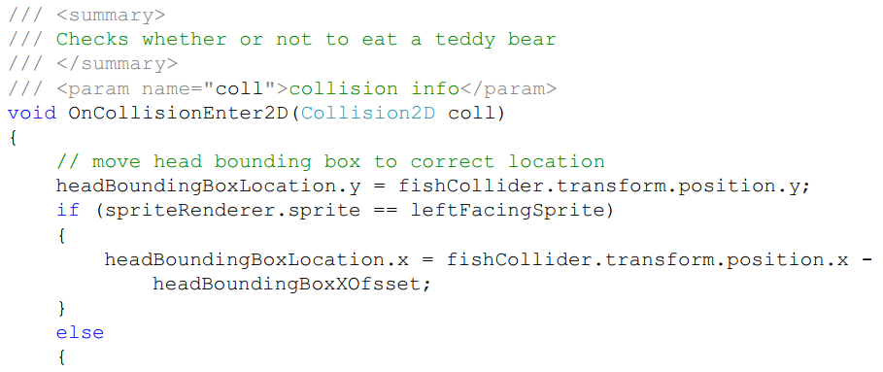
5.5 Putting It All Together
Write the Code

Slide 24
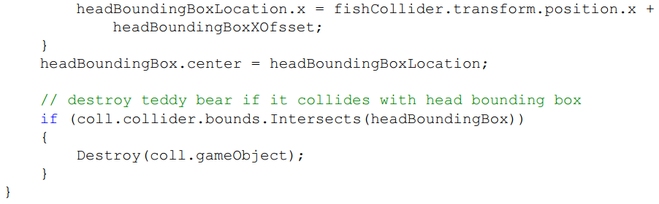
5.5 Putting It All Together
Write the Code

Slide 25
5.5 Putting It All Together
Test the Code
Test case 1
Test case 2
Test case 3

Slide 26
Summary
The Input Manager
Mouse Input
Keyboard Input
Gamepad Input

